Slide 1
How a Component is Displayed?
User interface components like JButton cannot be displayed without being placed in a container. A container is a component that is capable of containing other components. You do not display a user interface component; you place it in a container, and the container displays the components it contains.
The base class for all containers is java.awt.Container, which is a subclass of java.awt.Component. The Container class has the following essential functions:

Slide 2
What Does a Container Do?
The base class for all containers is java.awt.Container, which is a subclass of java.awt.Component. The Container class has the following essential functions:
It adds and removes components using various add and remove methods.
It maintains a layout property for specifying a layout manager that is used to lay out components in the container. Every container has a default layout manager.
It provides registration methods for the java.awt.event.ContainerEvent .

Slide 3
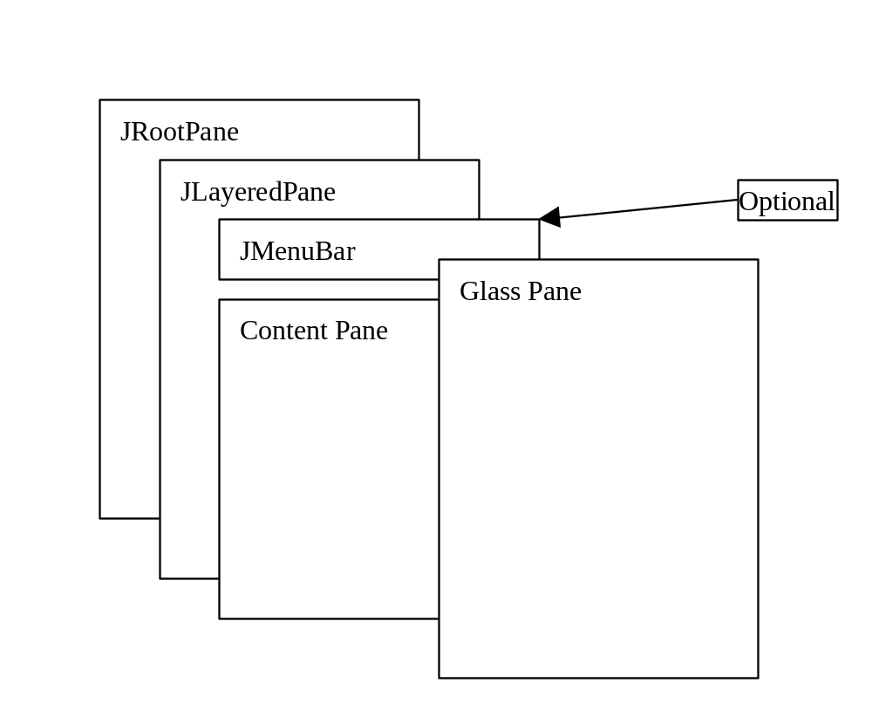
Structures of the Swing Containers
A lightweight container used behind the scenes by Swing's top-level containers, such as JFrame, JApplet, and JDialog
The glass pane floats on top of everything. It is a hidden pane by default.
A container that manages the optional menu bar and the content pane
The content pane is an instance of Container. By default, it is a JPanel with BorderLayout. This is the container where the user interface components are added.

Slide 4
JFrame
JFrame, a Swing version of Frame, is a top-level container for Java graphics applications. Like Frame, JFrame is displayed as a standalone window with a title bar and a border. The following properties are often useful in JFrame.
  contentPane
  iconImage
  jMenuBar
  layout
  title
  resizable

Slide 5
JApplet
JApplet is a Swing version of Applet. Since it is a subclass of Applet, it has all the functions required by the Web browser. Here are the three essential methods defined in Applet:
  contentPane
  jMenuBar
  layout

Slide 6
JPanel
Panels act as sub-containers for grouping user interface components. javax.swing.JPanel is different from JFrame and JApplet. First, JPanel is not a top-level container; it must be placed inside another container, and it can be placed inside another JPanel. Second, since JPanel is a subclass of JComponent, it is a lightweight component, but JFrame and JApplet are heavyweight components.

Slide 7
About Layout Managers
Each container has a layout manager, which is responsible for arranging the components in a container.
The container's setLayout method can be used to set a layout manager.
Certain types of containers have default layout managers.
The layout manager places the components according to the layout manager's rules, property settings and the constraints associated with each component.
Each layout manager has a particular set of rules specific to that layout manager.

Slide 8
The Size of Components in a Container
The size of a component in a container is determined by many factors, such as:
The type of layout manager used by the container.
The layout constraints associated with each component
The size of the container.
Certain properties common to all components (such as preferredSize, minimumSize, maximumSize, alignmentX, and alignmentY).

Slide 9
preferredSize, minimumSize, and maximumSize
The preferredSize property indicates the ideal size at which the component looks best. Depending on the rules of the particular layout manager, this property may or may not be considered. For example, the preferred size of a component is used in a container with a FlowLayout manager, but ignored if it is placed in a container with a GridLayout manager.
The minimumSize property specifies the minimum size at which the component is useful. For most GUI components, minimumSize is the same as preferredSize. Layout managers generally respect minimumSize more than preferredSize.
The maximumSize property specifies the maximum size needed by a component, so that the layout manager won't wastefully give space to a component that does not need it. For instance, BorderLayout limits the center component's size to its maximum size, and gives the space to edge components.

